Slide 1
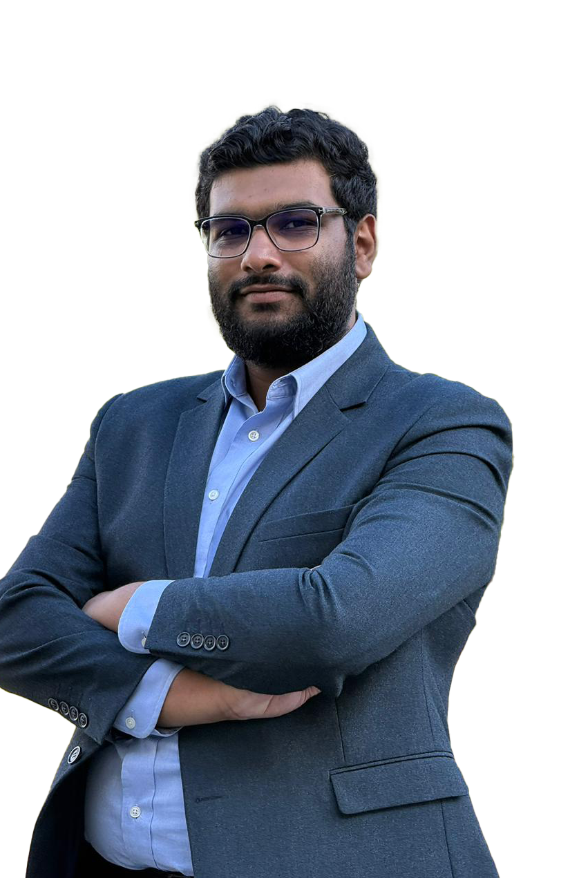



Hello, I am
Farhaan Beeharry
Mobile Developer/Software Engineer
I’m a software engineer with 4 years of experience, passionate about turning ideas into impactful digital solutions.
My inspiration comes from innovation, creativity, and the drive to build tools that make life simpler.
CRAFTING MY PATH
(230) 5707 6881
contact@farhaan.info
https://www.farhaan.info
2025

Slide 2
My Skill
Education & Certifications
University
Academy
CRAFTING MY PATH
September 2021
January 2022
BSc Computer Science (Systems Engineering)
ELCAdemy
Middlesex University, Mauritius
Information Technology ELCA Ltd
Earned a First Class Honours
Built a strong foundation in software and system design
Gained hands-on experience in software development and enterprise systems.
2025

Slide 3
Over the years, I’ve gained hands-on experience building scalable digital products across multiple industries. My focus has always been on delivering solutions that bring real value to users and businesses.
About Me
Work Experience
2021
2023
Present
CRAFTING MY PATH
Aug 2021 – May 2023
Jun 2023 – Sep 2024
Oct 2024 - Present
Information Technology ELCA Ltd
Kurrent (ex EventStore)
DietSensor
Weartwice
XEFI Centre Mauritius
Remote, United Kingdom
Ebène, Mauritius
St Pierre, Mauritius
Remote, France
2025
Remote, United Arab Emirates

Slide 4
Awards
Achievment & Rewards
2020
2021
2022
2023
CRAFTING MY PATH
Digicup
UoM - Techwar
Mobile App Design
InovApp 3.0
Second prize winner
Second prize winner
Third prize winner
🏆 First prize winner 🏆
inovapp.mu
2025

Slide 5
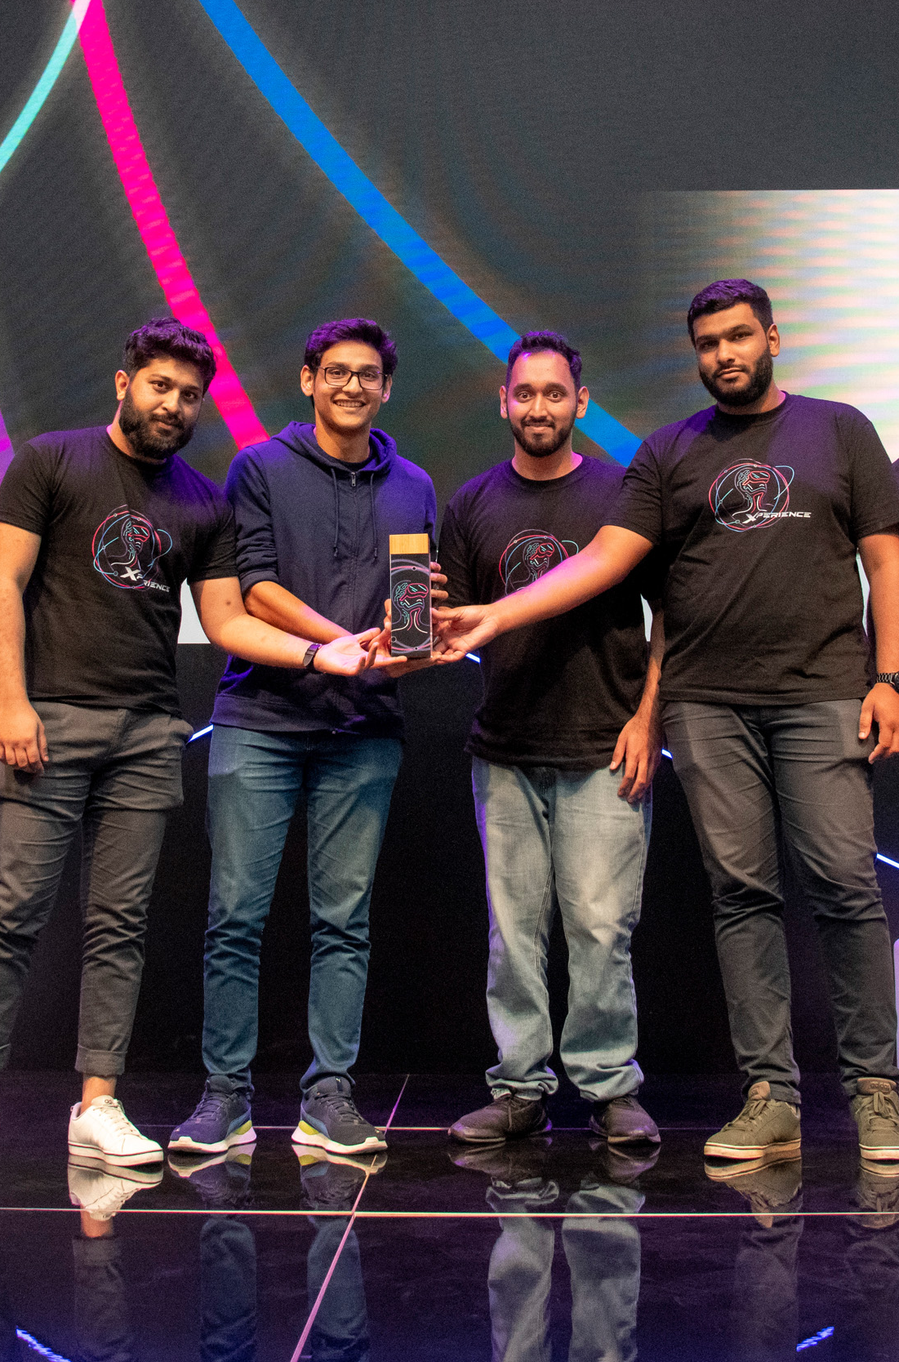
About InovApp Challenge 3.0
Innovate. Create. Transform.
The MCB InovApp Challenge 3.0 is a premier hackathon that brings together talented minds, from students to start-ups, to create next-generation solutions for the banking sector and beyond.
Participants collaborate in teams over an intense 24-hour sprint to design innovative, high-impact digital products.
The event fosters creativity, teamwork, and real-world problem-solving, offering a platform to showcase skills and drive meaningful change.
🏆 First prize winner 🏆
CRAFTING MY PATH
2025

Slide 6





My Skill
Technology Skills
Flutter
85%
NodeJS
CRAFTING MY PATH
80%
Angular
75%
Java (Spring/Spring Boot)
65%
2025

Slide 7
My Skill
Core Competencies
Mobile & Web Development
Technical Leadership
System Architecture
CRAFTING MY PATH
Building scalable, high-performance apps with Flutter and modern techs.
Guiding projects and teams with clarity, collaboration and ownership.
Creating efficient, secure and maintainable system structures.
Problem Solving
Agile Practices
UI/UX Implementation
Transforming challenges into creative, impactful digital solutions.
Delivering quality through agile and result-driven workflows.
Blending design precision with usability for seamless experiences.
2025

Slide 8
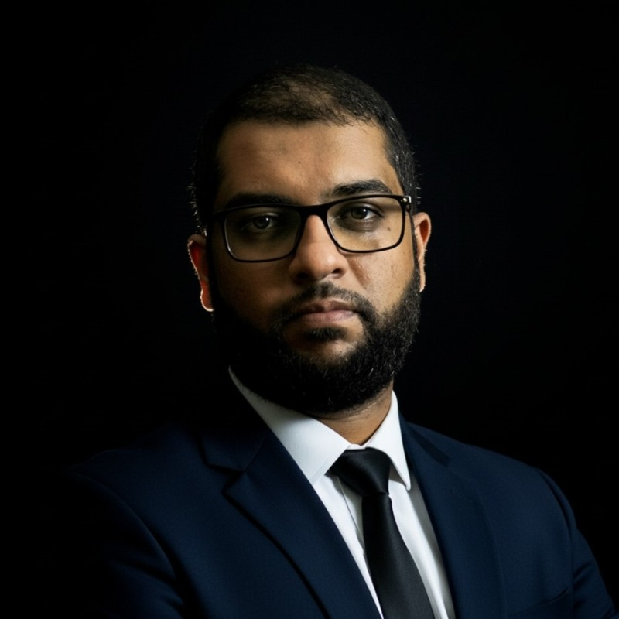
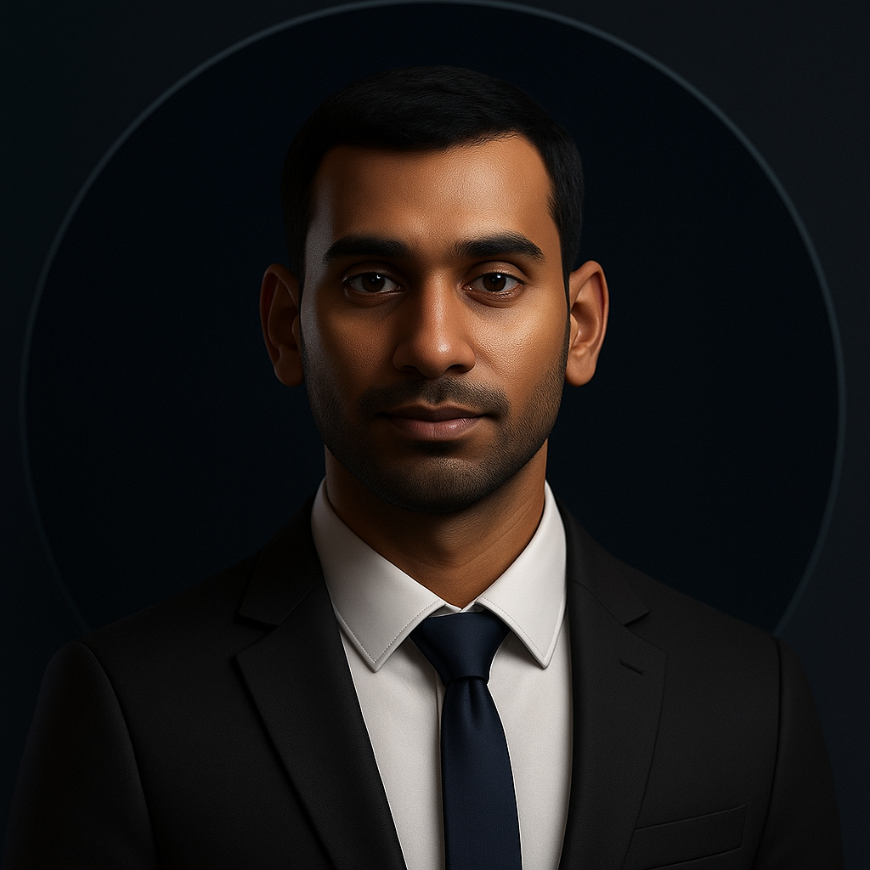
Testimonial
Testimonials / References
“
“
Working with Farhaan Beeharry was a real pleasure. He’s a skilled and dependable Flutter developer who consistently delivers high‑quality work. What stood out most was how easy and pleasant he was to work with. He’s friendly, respectful, and a genuine team player.
I’ve seen Farhaan grow rapidly as a Flutter developer. He’s a quick learner who takes initiative, asks the right questions, and translates feedback into tangible improvements. A great teammate with strong potentials.
CRAFTING MY PATH
Zubair Tofy
Dheeraj Tilhoo
Co-founder & Lead Developer
MetaBox Technologies
Lead Flutter Developer
XEFI Centre Mauritius
2025

Slide 9
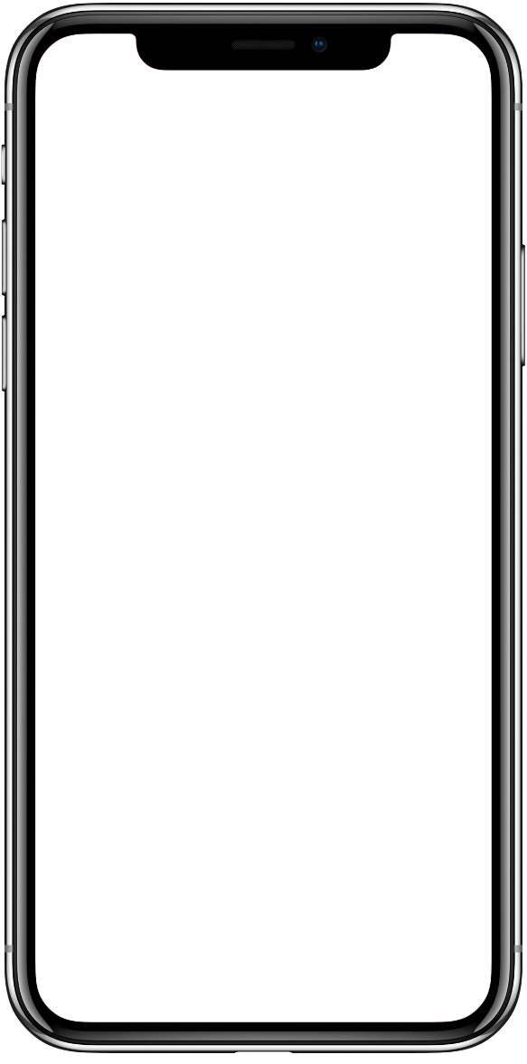
Projects
DailyApps
aaaaaaaaaaaaaaaaaaaaa
CRAFTING MY PATH
2025

Slide 10
Projects
Kalydian
aaaaaaaaaaaaaaa
CRAFTING MY PATH
2025

Slide 11
Projects
WearTwice
aaaaaaaaaaaaaaa
CRAFTING MY PATH
2025

Slide 12

Projects
Candidate Assessment System
aaaaaaaaaaaaaaaaa
CRAFTING MY PATH
2025

Slide 13
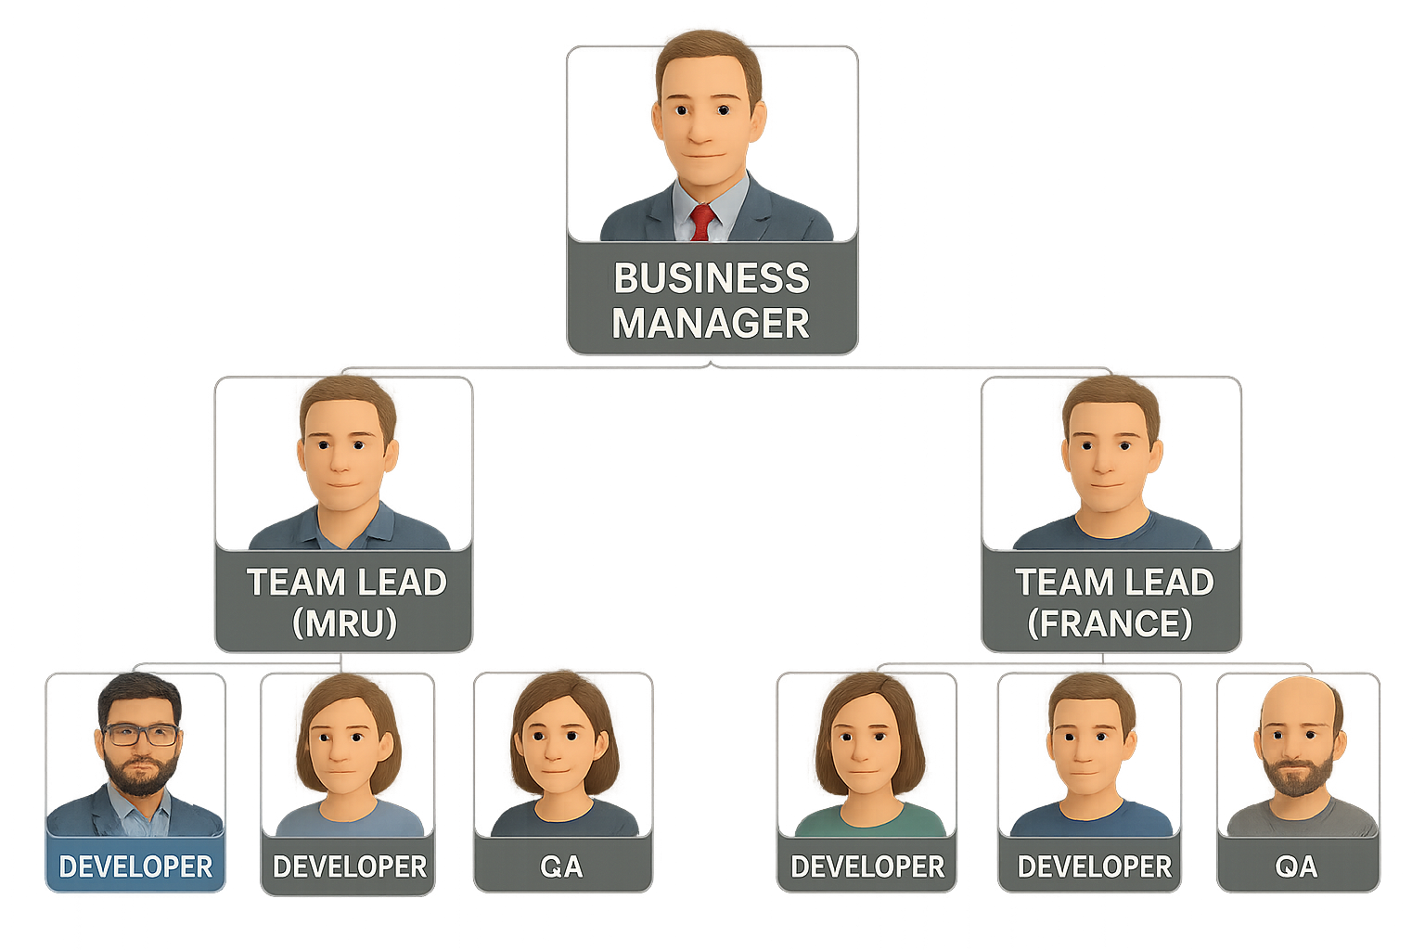
My Experience
Team Structure & My Role
About my Experiences
aaaaaaaaaaaaaaaaaaaaa
aaaaaaaaaaaaaaaaaaaaa
CRAFTING MY PATH
Agile Methodology
aaaaaaaaaaaaaaaaa
2025
Me

Slide 14
Project Fit
Why Am I Interested in Amadeus?
CRAFTING MY PATH
Reason 1
Reason 2
Reason 3
aaaaaaaaaaa
aaaaaaaaaaaa
aaaaaaaaaaaaa
2025

Slide 15

Thank You
For Your Attention
CRAFTING MY PATH
(230) 5707 6881
contact@farhaan.info
https://www.farhaan.info
2025

